Slide 1

Integrating Mobile IoT Devices into the Arrowhead Framework Using Web of Things
Chiara Bonsignori, Carlo Puliafito,
Antonio Virdis, Enzo Mingozzi, Giuseppe Iannaccone

Slide 2
Outline
Integration of legacy IoT devices within the Arrowhead Framework (AHF) through WoT
Using WoT towards mobility/migration support
Performance evaluation
Conclusions and future work

Slide 3


Integration of legacy IoT devices within the AHF through WoT
The Arrowhead Framework (AHF) is an open-source platform for IoT interoperability and is currently supported as a project of the Eclipse Foundation²
Developed across several EU projects. We specifically worked in the Arrowhead Tools EU project³
Main Objective: provide tools, platforms, engineering processes towards industrial automation
80+ Partners from 18 EU Countries
3 Years (May 2019 – July 2022)
Legacy devices: Devices that do not natively talk the same language nor use the same protocols of AHF entities.
² https://projects.eclipse.org/projects/iot.arrowhead
³ https://www.arrowhead.eu/arrowheadtools

Slide 4
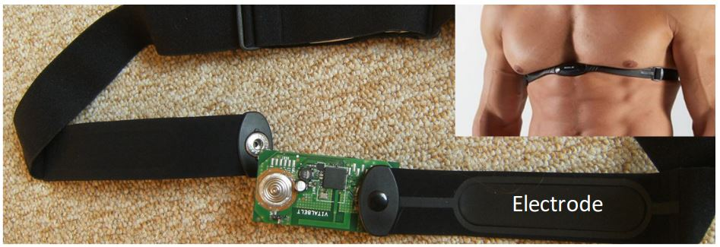
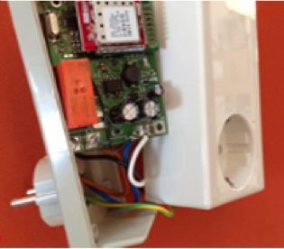
Integration of legacy IoT devices within the AHF³
ECG device⁴
Size: 6.5 cm x 3.4 cm
BOM cost: <10$
Battery life: five days
Sampling rate: 320 Hz
Transmission rate: 5 kbps
Smart plug⁵
Size: 7.7 cm x 5.7 cm (without external case)
BOM cost: <15$
Monitors: active and reactive power, voltage, and current.
Remotely turn it on or off
³Work carried out within the scope of the Arrowhead Tools EU project: https://www.arrowhead.eu/arrowheadtools
⁴E. Spanò, S. Di Pascoli, and G. Iannaccone, “Low-power wearable ECG monitoring system for multiple-patient remote monitoring,” IEEE Sensors Journal, vol. 16, no. 13, pp. 5452–5462, 2016.
⁵E. Spanò, L. Niccolini, S. D. Pascoli, and G. Iannaccone, “Lastmeter smart grid embedded in an Internet-of-Things platform,” IEEE Transactions on Smart Grid, vol. 6, no. 1, pp. 468–476, 2015.

Slide 5
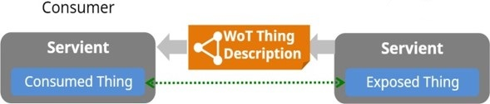
Web of Things (WoT) – Main Components
Web Thing
Abstracts a physical or virtual entity
Has a JSON Thing Description (TD) associated
Consumer
Fetches and processes TD
Instantiates a Consumed Thing
Servient
A software environment that can expose and/or consume Web Things
Exposer
Advertises TD
Instantiates an Exposed Thing
Exposer

Slide 6
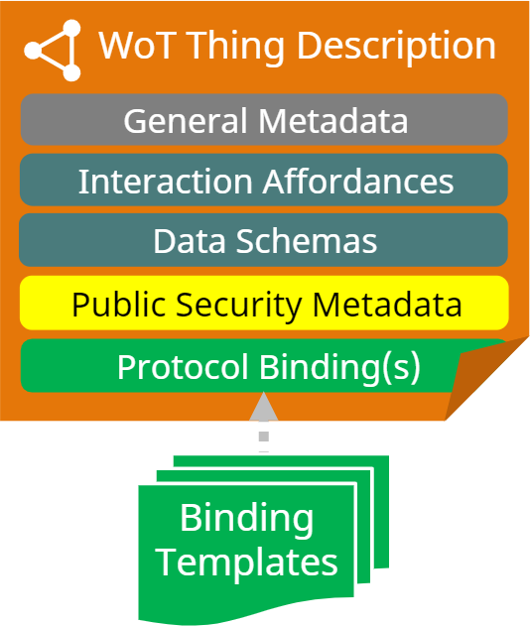
Thing Description
Interaction Affordances
The capabilities offered by the Thing
Properties: state of the Thing
Actions: functions provided to manipulate the state
Events: to asynchronously notify Consumers
Protocol Bindings
Mapping from Interaction Affordances to concrete messages of protocols (HTTP, CoAP, MQTT, ….)

Slide 7
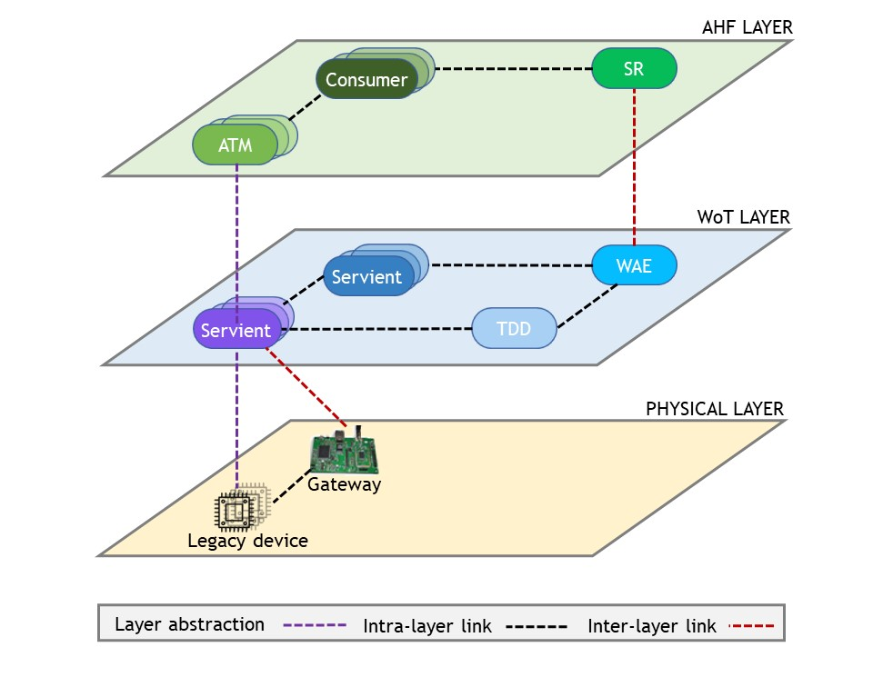
Integration architecture
AHF consumers in a local cloud can access legacy devices
This architecture opens up opportunities towards edge computing

Slide 8

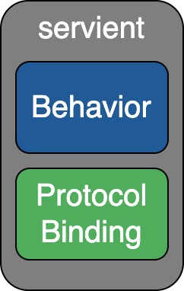


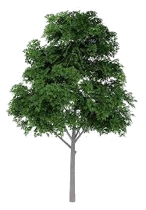


Mobility/migration of WoT servients in edge computing

Slide 9
Using WoT towards mobility/migration support
State management
We consider stateful servients at the edge. How to handle the state?
Managing (i.e., save, transfer, and restore) the state at the application-level is not transparent to the application itself
We choose to host a servient inside a container and migrate it using container migration techniques, transparently to the application
Addressing
Mobility/migration typically causes IP addresses to change
It is possible to use auxiliary elements (e.g., DNS), which however introduce complexity and potential delays
Our mechanisms to recover connectivity:
Are designed as part of WoT itself
Involve only the two endpoints
Are transparent to the application logic

Slide 10
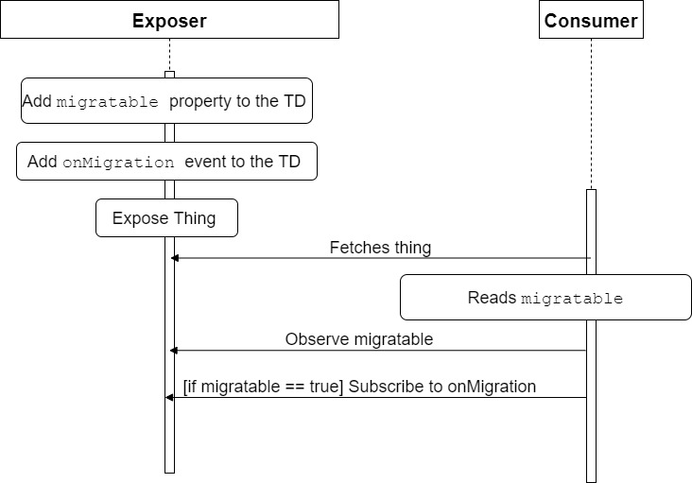
Mobility/Migration Support – Servient Migratability Configuration
10

Slide 11
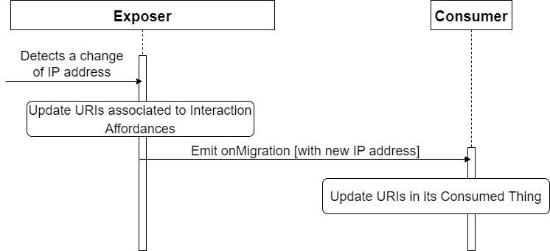
Mobility/Migration Support - Exposer Migration
After migration:
URIs of Interaction Affordances unreachable
notifications still received by Consumer
11

Slide 12
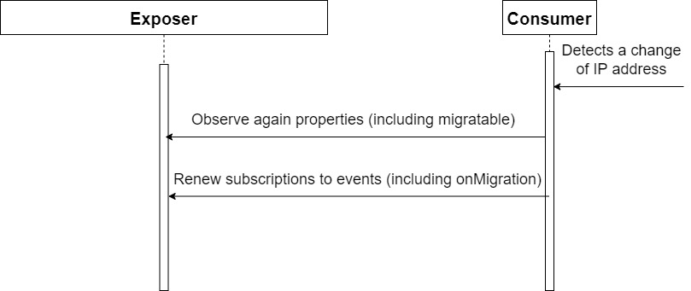
Mobility/Migration Support - Consumer Migration
After migration:
URIs of Interaction Affordances still reachable
notifications no more received by Consumer
Additional data structure is required
12

Slide 13
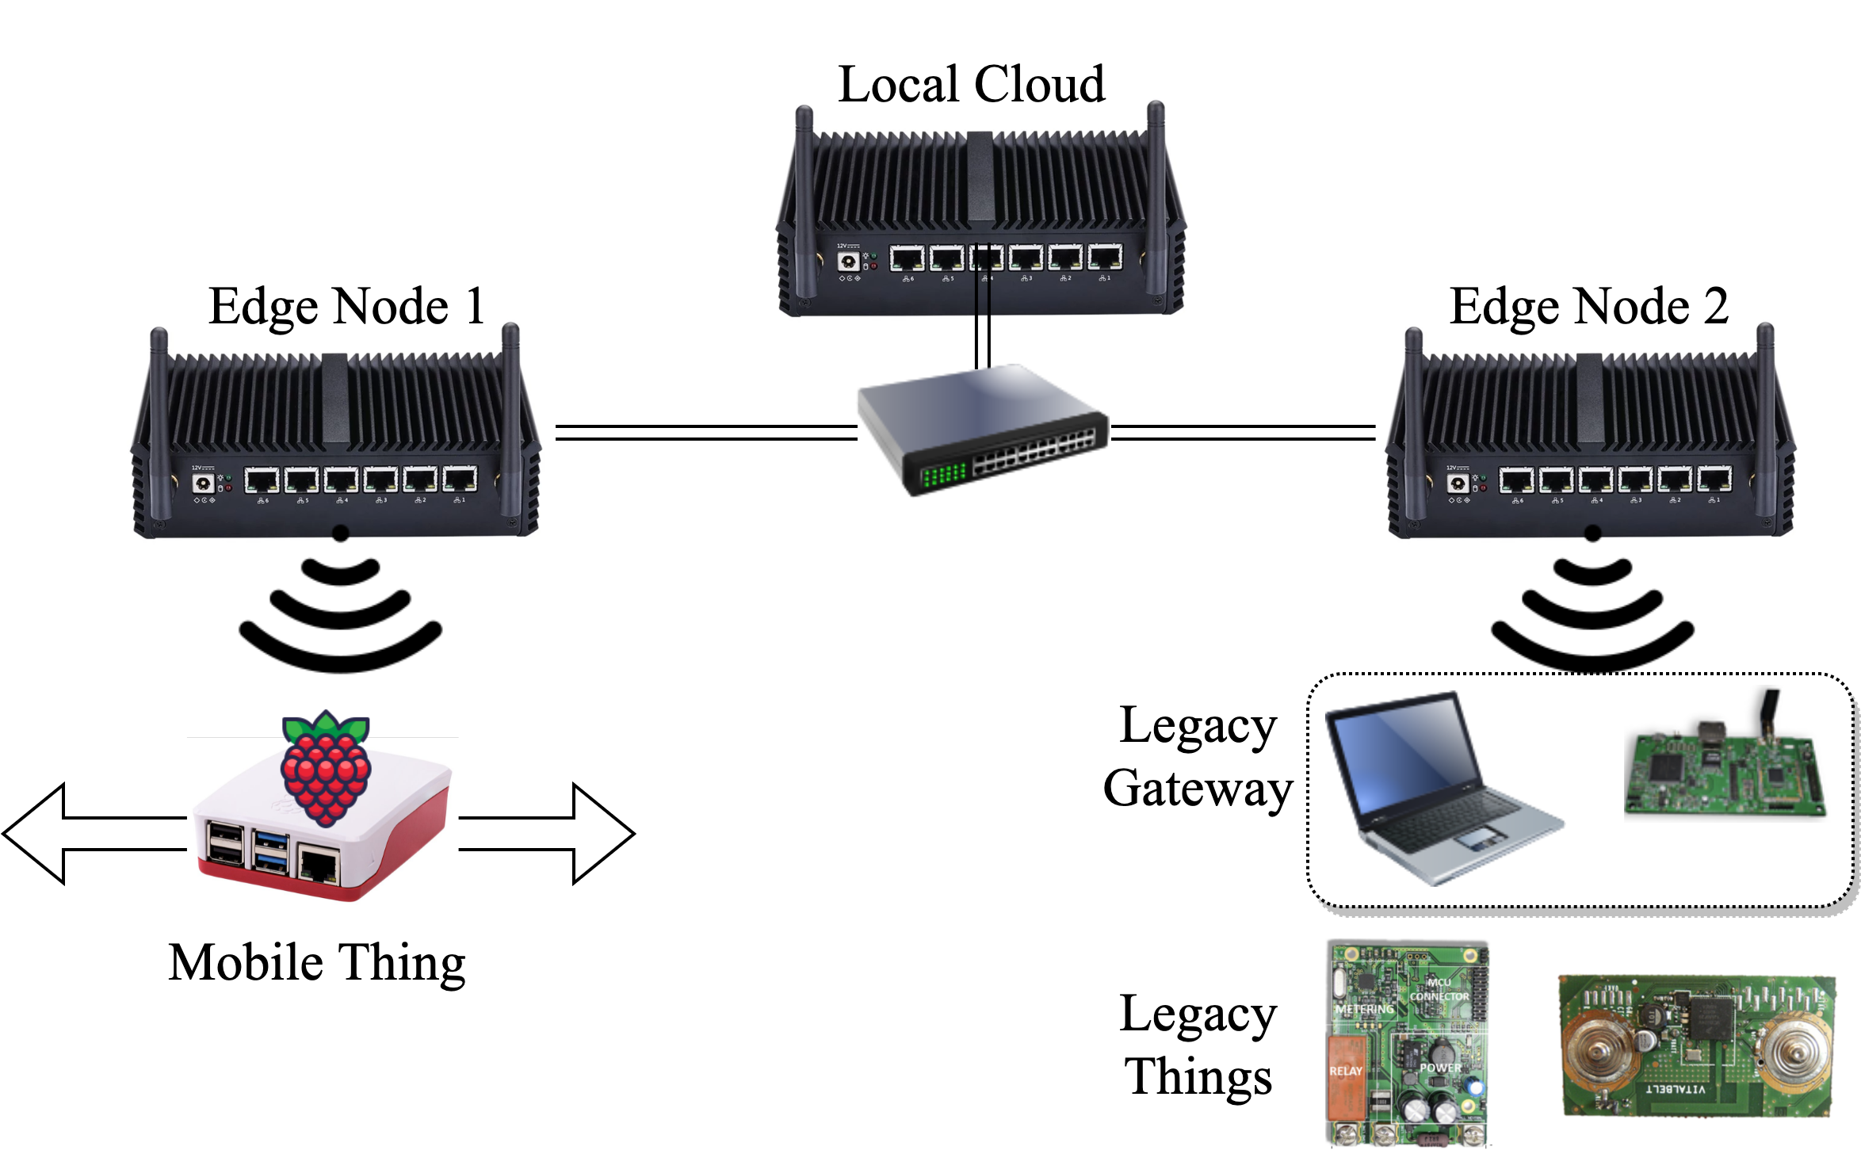
Performance evaluation - Testbed configuration
13

Slide 14
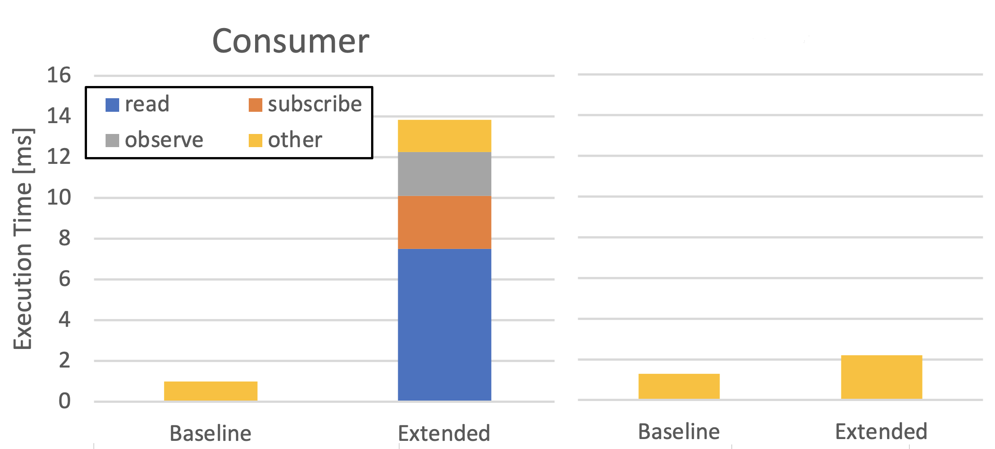
Execution time of the consume()and produce() methods
Exposer
14

Slide 15
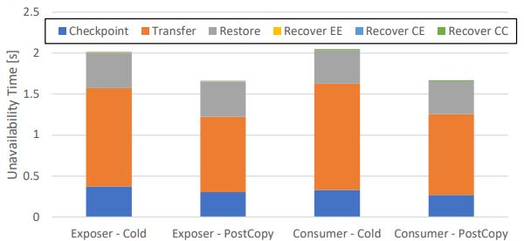
Unavailability time due to Exposer and Consumer migration
15

Slide 16
Conclusions
Integration of legacy devices (ECG and smart plug) into the AHF through WoT
Using WoT to support mobility/migration of servients in edge computing scenarios
Performance evaluation has shown a negligible overhead of our solution to baseline WoT and to the unavailability time perceived by endpoints
Future Work
Investigate the orchestration of the migration of multiple WoT servients
16

Slide 17
Thank you!
carlo.puliafito@ing.unipi.it

